Slide 1

Section 1.3 Lines
Lecture 1
Idea and Equations of Lines

Slide 2
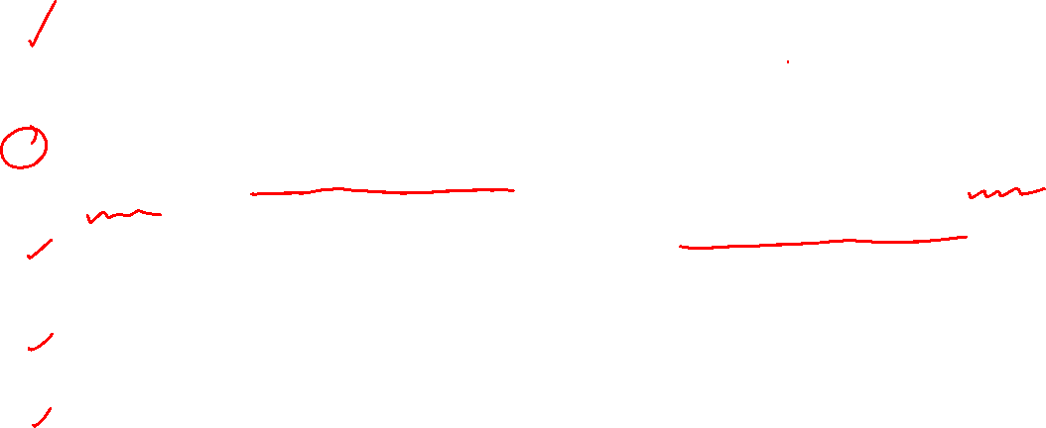
Section 1.3 Homework Submission to Canvas
Preview of section
Skim the section in text and write a short paragraph summary.
Give a bulleted list of all important definitions, theorems, and formulas without details.
Notes on video lectures
Take notes on everything written on slides including all details, worked examples, on-own activities, as well as your own thoughts and questions.
Try on-own activities first, then write down provided solution next to it for comparison.
Worked examples from the text
Write down the problem and attempt without looking at the solution.
Use the solution to write the best explanation you can.
Solutions to textbook exercises
Model approaches and explanations given in the video lectures and textbook examples.
Final reflection of section
List the key takeaways to remember as a bulleted list.

Slide 3
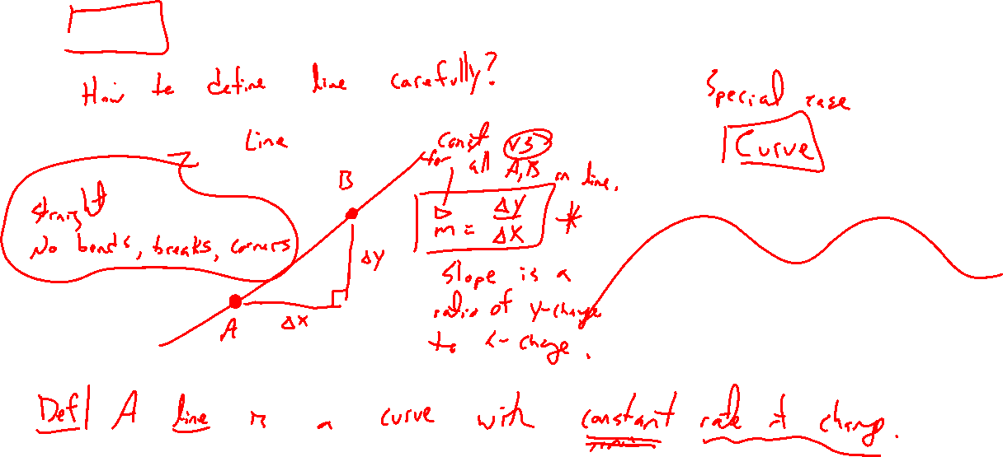
Idea of Lines
Notes:
Draw line and curve.
How to carefully distinguish? Line has constant rate of change, known as the slope. (draw many cases of lines)

Slide 4
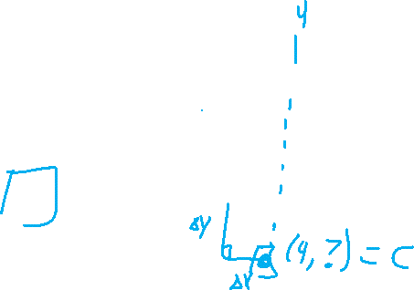
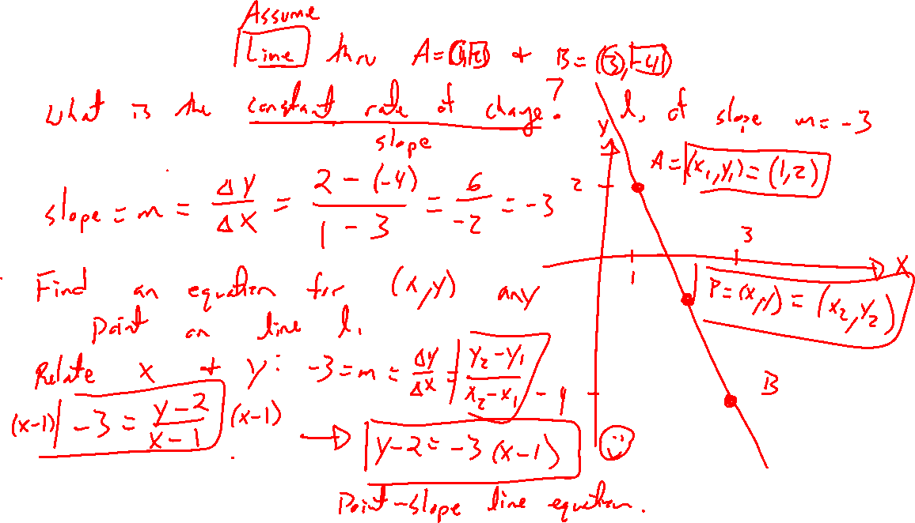
Example:
Notes:
Line thru points (1,2) and (3,-4). What is the constant rate of change?
m = (y2-y1)/(x2-x1)= -3=\delta y/\delta x = rise/run
How to define in general for any point (x,y)? Slope still should hold.
m = (y-y1)/(x-x1)= -3 for any point on the line.
Leads to point-slope form.
Find another point on line and double check slope is the same.

Slide 5
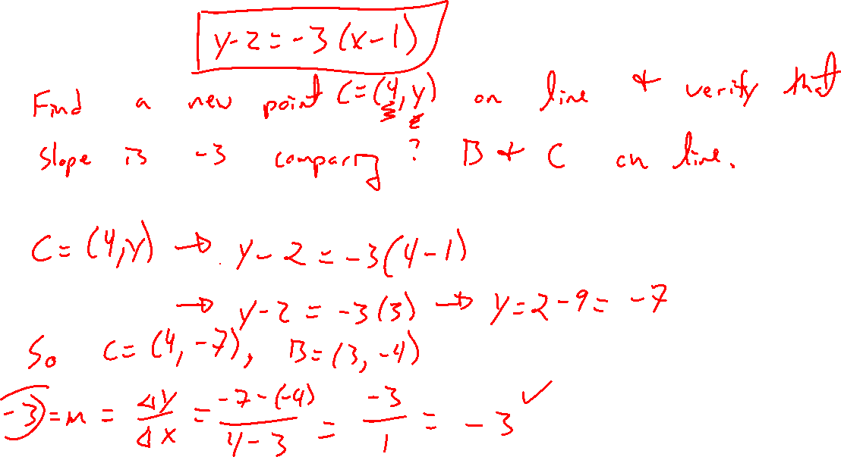
Example:

Slide 6
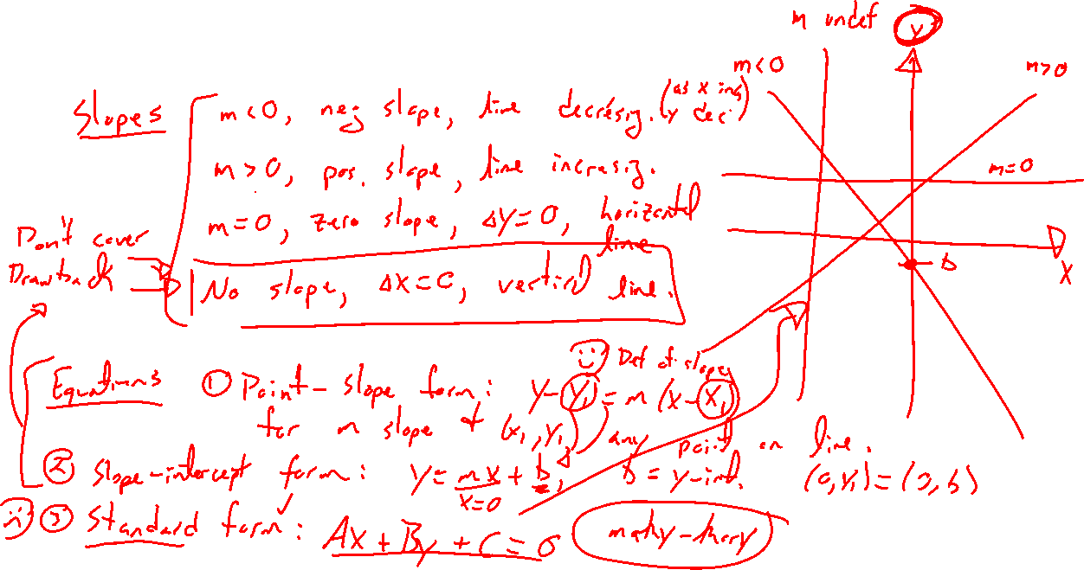
Equations and Cases of Lines
Notes:
Slopes: Positive, negative, zero, none
Point-slope form (reaffirms constant change), slope intercept (simple, know where you start), standard form Ax+By+C=0 (most general, every line captured, many equations for same line, nice for theory)
Which form is best? Different intuition of each, different interpretation

Slide 7
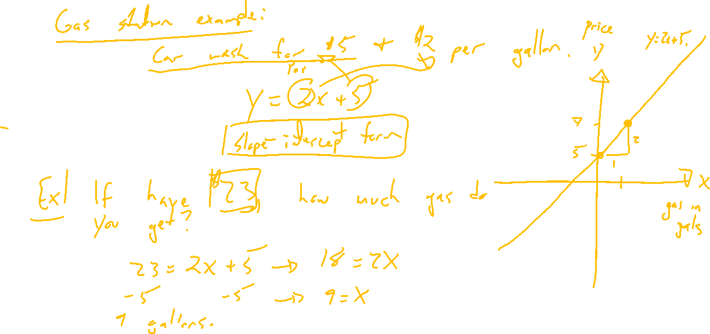
Interpretation of Lines
Notes:
Getting gas and car wash
CPG = 2$
Car wash cost = 5$
Y=2x+5
General slope-intercept form: Y=mx+b
How much gas can you get if only have 20$?

